Slide 1
Chapter 1
Introduction to Computers and Programming
STARTING OUT WITH
Python
First Edition
by
Tony Gaddis

Slide 2
1.1 Introduction
People use computers at…
  School for writing papers, research, email, online classes, etc.
  Work for analyzing data, make presentations, business transactions, communicating, control machines, etc.
  Home for paying bills, shopping online, communicating, playing computer games, etc.
  What are some of the ways you use computers?
1-

Slide 3
1.1 Introduction
Devices that are computers…
  Cell Phones
  iPods
  Blackberries
  Car navigation system (GPS)
  Can you think of some other devices that are computers?
1-

Slide 4
1.1 Introduction
Computers are designed to do any job that their programs tell them to do.
  A program is a set of instructions that a computer follows to perform a task.
      For example: Microsoft Word and Adobe Photoshop
Programs are commonly referred to as software.
  What software have you used?
1-

Slide 5
1.1 Introduction
Programmers or Software Developers are the individuals that create computer software.
They have the training and skill to design, create, and test computer programs.
  What are some of the fields in which computer programs are used?
1-

Slide 6
1.2 Hardware and Software
Concept:
The physical devices that a computer is made of are referred to as the computer’s hardware. The programs that run on a computer are referred to as software.
1-

Slide 7
1.2 Hardware and Software
Hardware
The physical devices that a computer is made of are referred to as the computer’s hardware.
A computer is a system of devices that work together.
1-

Slide 8
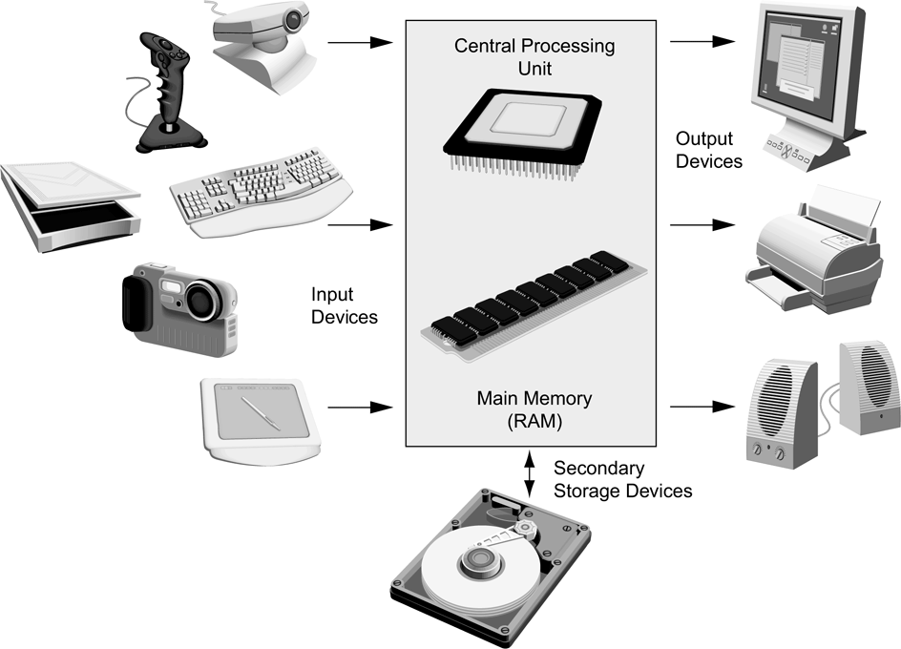
1.2 Hardware and Software
  Hardware
  A Computer System consists of:
  Central Processing Unit (CPU)
  Main memory
  Secondary storage
  Input devices
  Output devices
Figure 1-2 Typical components
of a computer system
1-

Slide 9
1.2 Hardware and Software
  Hardware
  Central Processing Unit (CPU)
    The CPU is the part of a computer that runs the programs.
    Without a CPU a computer cannot run software.
  Running or executing a program is the term used when the computer performs the tasks that the program tells it to do.
1-

Slide 10
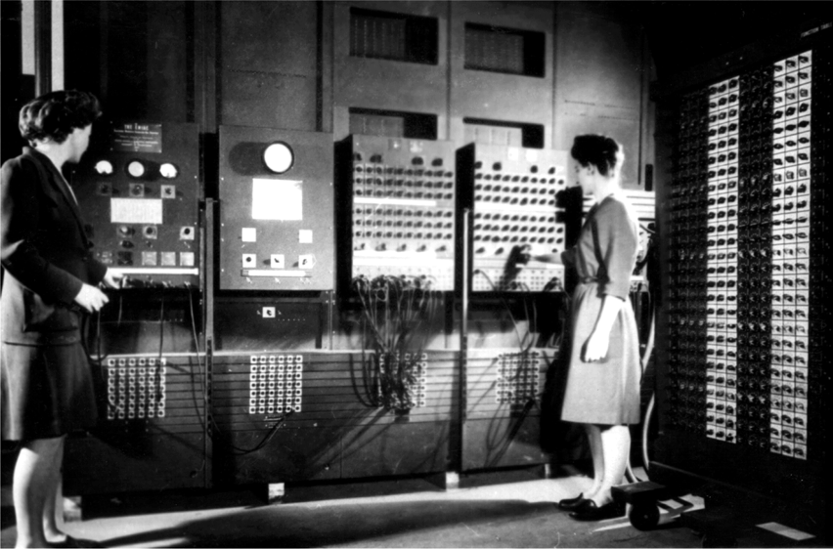
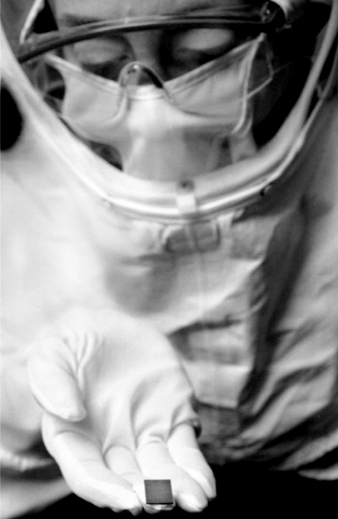
1.2 Hardware and Software
  Hardware
  ENIAC
    World’s first programmable computer
    Built in 1945
    Designed to calculate artillery ballistic tables for the U.S. Army
    CPU was 8 feet tall, 100 feet long, and weighed 30 tons
  Microprocessor
    Much smaller
    Much more powerful
Figure 1-3 The ENIAC computer (courtesy of U.S. Army Historic Computer Images)
Figure 1-4
A lab technician holds a modern microprocessor (photo courtesy of Intel
Corporation)
1-

Slide 11
1.2 Hardware and Software
  Hardware
  Main Memory
    Considered the computer’s work area
    Computer stores the program that is running as well as the data
    Commonly known as the random-access memory (RAM)
    Data is quickly accessed
    RAM is a volatile type of memory
    Used for temporary storage
    RAM is erased when computer is turned off
1-

Slide 12
1.2 Hardware and Software
  Hardware
  Secondary Storage Devices
    Type of memory that can hold data for long periods of time.
    Programs and important data are stored in secondary storage
    Disk drive is a common type of secondary storage
      Data is stored by magnetically encoding it onto a circular disk
      Most computers have an internal disk drive
      Some have external disk drives; they are used to create backup copies
    Floppy drives record data onto a small floppy disk
      Holds only a small amount of data
      Slow to access data
      Can be unreliable
1-

Slide 13
1.2 Hardware and Software
  Hardware
  Secondary Storage Devices
    USB drives are small devices that plug into the computer’s universal serial bus (USB) port
      It does not contain a disk
      The data is stored on flash memory
      Also known as memory sticks and flash drives
      Inexpensive, reliable, and small
    Optical devices (CD or DVD)
      Data is encoded as a series of pits on the disc’s surface
      Uses laser to encode the data
      Holds large amounts of data
      Good medium for creating backups
1-

Slide 14
1.2 Hardware and Software
  Hardware
  Input Devices
    Any data the computer collects from people and from other devices is called input.
    The hardware component that collects the data is called an input device.
    Common input devices are:
      Keyboard
      Mouse
      Scanner
      Microphone
      Digital camera
  Can you think of any other input devices?
1-

Slide 15
1.2 Hardware and Software
  Hardware
  Ouput Devices
    Any data the computer produces for people or for other devices is called output.
    The hardware component that formats and presents the data is called an output device.
    Common output devices are:
      monitor
      Printer
  Can you think of any other output devices?
1-

Slide 16
1.2 Hardware and Software
  Software
  Everything a computer does is controlled by software.
  Two categories of software:
    System software
    Application software
1-

Slide 17
1.2 Hardware and Software
  Software
  System Software
  Programs that control and manage the basic operations of a computer are referred to as system software.
  Includes the following types:
    Operating System controls the internal operations of the computer’s hardware and manages all of the devices connected to the computer.
    Utility Programs perform a specialized task that enhances the computer’s operation or safeguards data.
    Software Developments Tools are programs that are used to create, modify, and test software.
1-

Slide 18
1.2 Hardware and Software
  Software
  Application Software
  Programs that people normally spend most of their time running on their computers performing everyday tasks are referred to as application software.
  For example:
    Word processing
    Spreadsheet
    Database
    Presentation
    Can you think of any other application software?
1-

Slide 19
1.3 How Computers Store Data
Concept:
All data that is stored in a computer is converted to sequences of 0s and 1s.
1-

Slide 20
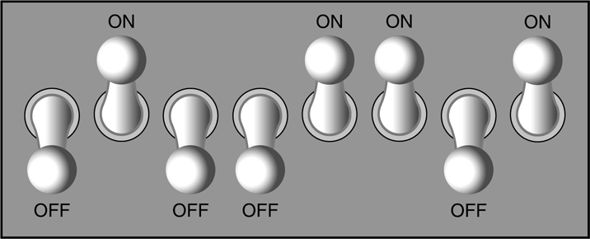
1.3 How Computers Store Data
      A computer’s memory is divided into tiny storage locations known as bytes
      One byte represents one number
      A byte is divided into eight smaller storage locations known as bits (binary digits)
      Bits are tiny electrical components that can hold either a positive or a negative charge.
      A positive charge is similar to a switch in the on position
      A negative charge is similar to a switch in the off position
Figure 1-7 Think of a byte as eight switches
1-

Slide 21
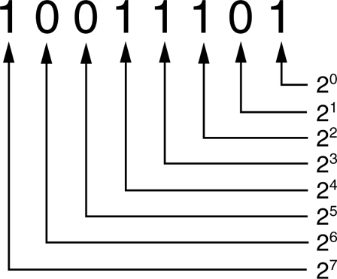
1.3 How Computers Store Data
      Storing Numbers
      The positive charge or the on position is represented by the digit 1
      The negative charge or the off position is represented by the digit 0
      This corresponds to the binary numbering system where all numeric values are written as a sequence of 0s and 1s
      Each digit in a binary number has a value assigned to it
Figure 1-9 The values of binary digits as powers of 2
1-

Slide 22
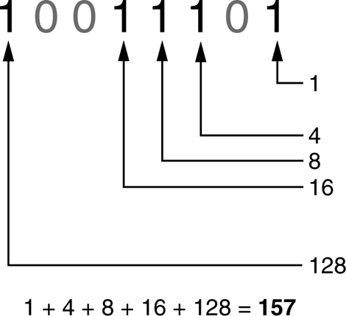
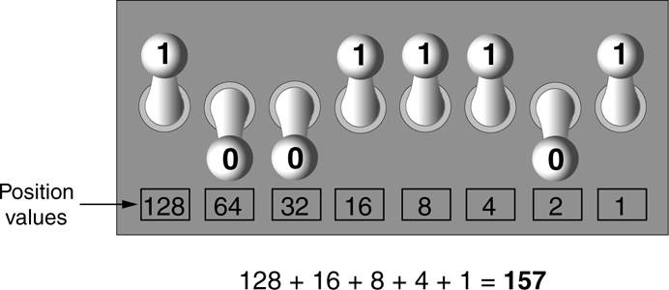
1.3 How Computers Store Data
      Storing Numbers
      For example:
Figure 1-11 Determining the value of 10011101
Figure 1-12 The bit pattern for 157
1-

Slide 23
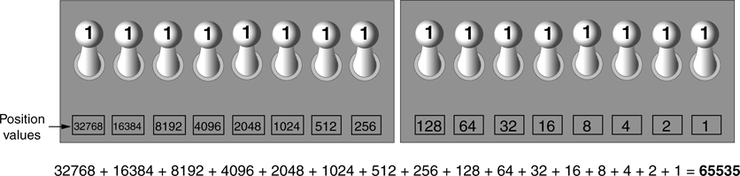
1.3 How Computers Store Data
      Storing Numbers
      The largest value that can be stored in a byte with eight bits is 255
      Two bytes are used for larger numbers; maximum value is 65535
Figure 1-13 Two bytes used for a large number
1-

Slide 24
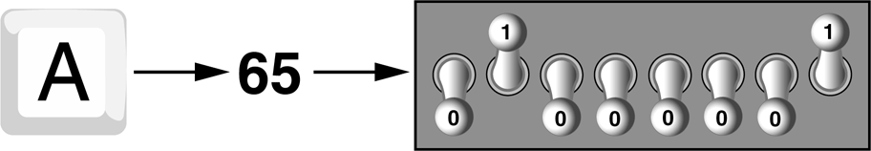
1.3 How Computers Store Data
      Storing Characters
      Characters are stored in the computer’s memory as binary number
      ASCII (American Standard Code for Information Interchange) is a coding scheme
Figure 1-14 The letter A is stored in memory as the number 65
1-

Slide 25
1.3 How Computers Store Data
      Storing Characters
      ASCII is a set of 128 numeric codes
      ASCII is limited
      Unicode is an extensive encoding scheme
        It is compatible with ASCII
        It represents characters for many languages in the world
1-

Slide 26
1.3 How Computers Store Data
      Advanced Number Storage
      Binary numbering system can be used to represent only integer numbers
      Negative numbers are encoded using two’s complement
      Real numbers are encoded using floating-point notation
1-

Slide 27
1.3 How Computers Store Data
      Other Types of Data
      Digital data is data that is stored in binary
      A digital device is any device that works with binary data
      Digital images are composed of tiny dots of color known as pixels (picture elements)
      Digital sound is broken into small pieces known as samples
1-

Slide 28
1.4 How a Program Works
Concept:
A computer’s CPU can only understand instructions that are written in machine language. Because people find it very difficult to write entire programs in machine language, other programming languages have been invented.
1-

Slide 29
1.4 How a Program Works
      CPU is the most important component in a computer
      CPU is not a brain
      CPU is not smart
      CPU is an electronic device that is designed to do specific things.
1-

Slide 30
1.4 How a Program Works
      CPU is designed to perform the following operations:
        Read a piece of data from main memory
        Adding two numbers
        Subtracting one number from another number
        Multiplying two numbers
        Dividing one number by another number
        Moving a piece of data from one memory location to another
        Determining whether one value is equal to another value
1-

Slide 31
1.4 How a Program Works
      CPU only understands instructions written in machine language
      Machine language instructions are written in 1s and 0s
      The entire set of instructions that a CPU can execute is known as the CPU’s instruction set
      Each brand of microprocessors (Intel, AMD, and Motorola) has a unique instruction set
1-

Slide 32
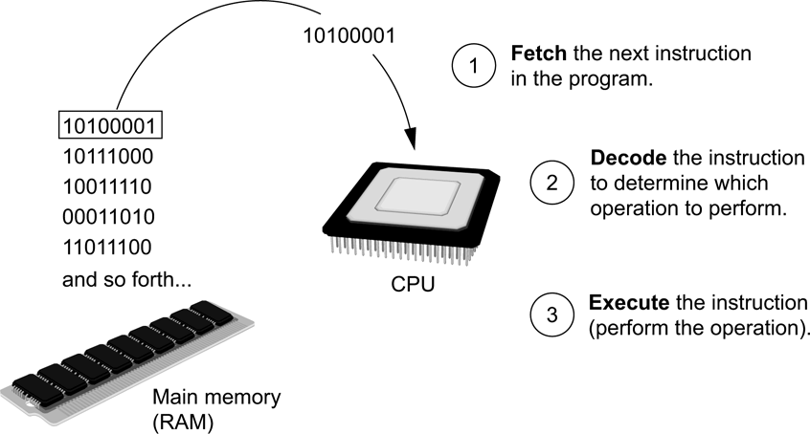
1.4 How a Program Works
      Fetch-decode-execute cycle is the term used when the CPU executes the instructions in a program.
      The cycle consist of three steps:
        Fetch
        Decode
        Execute
Figure 1-17 The fetch-decode-execute cycle
1-

Slide 33
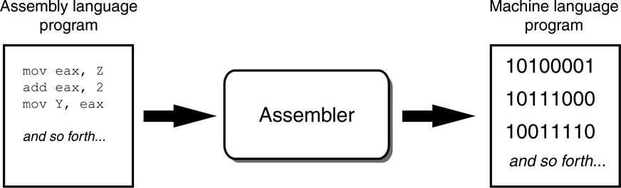
1.4 How a Program Works
      From Machine Language to Assembly Language
      Computers only understand machine language
      Machine language is difficult to write
      Assembly language uses short words that are known as mnemonics
      Assembler is used to translate an assembly language program to machine language
Figure 1-18 An assembler translates an assembly language program to a machine language program
1-

Slide 34
1.4 How a Program Works
      High-Level Languages
      Assembly language is referred to as a low-level language
      High-level languages allow you to create powerful and complex programs without knowing how the CPU works, using words that are easy to understand.
        For example:
        Ada, BASIC, Python, C++, Ruby, Visual Basic
    Do you know of any other high-level computer programming languages?
1-

Slide 35
1.4 How a Program Works
      Key Words, Operators, and Syntax: an Overview
      Key words or reserved words have specific meaning and purpose in the programming language
      Operators perform various operations on data
      Syntax is a set of rules that must be strictly followed when writing a program
      Statements are individual instructions written in a programming language
1-

Slide 36
1.4 How a Program Works
      Compilers and Interpreters
      The statements written in a high-level language are called source code or simply code
      Source code is translated to machine language using a compiler or an interpreter
      Syntax error is a mistake such as a:
        Misspelled word
        Missing punctuation character
        Incorrect use of an operator
1-

Slide 37
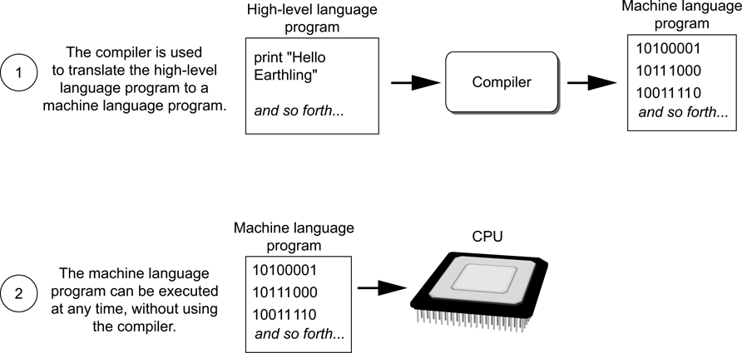
1.4 How a Program Works
      Compilers and Interpreters
      Compiler is a program that translates a high-level language program into a separate machine language program
Figure 1-19 Compiling a high-level program and executing it
1-

Slide 38
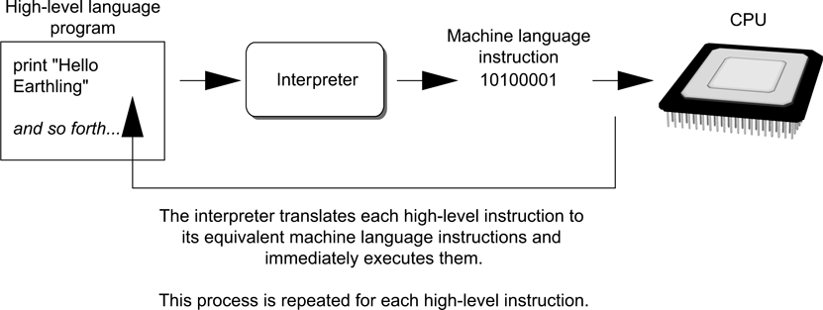
1.4 How a Program Works
      Compilers and Interpreters
      An interpreter is a program that both translates and executes the instructions in a high-level language program
      Python language uses an interpreter
Figure 1-20 Executing a high-level program with an interpreter
1-

Slide 39
1.5 Using Python
Concept:
The Python interpreter can run Python programs that are saved in files, or can interactively execute Python statements that are typed at the keyboard. Python comes with a program named IDLE that simplifies the process of writing, executing, and testing programs.
1-

Slide 40
1.5 Using Python
      The Python Interpreter
      A program that can read Python programming statements and execute them is the Python interpreter
      Python interpreter has two modes:
        Interactive mode waits for a statement from the keyboard and executes it
        Script mode reads the contents of a file (Python program or Python script) and interprets each statement in the file
1-

Slide 41
1.5 Using Python
      Interpreter Mode
      Invoke Python interpreter through Windows or command line
      >>> is the prompt that indicates the interpreter is waiting for a Python statement
        >>> print ‘Python programming is fun!’
        Python programming is fun!
        >>>
      Statements typed in interactive mode are not saved as a program
[ENTER]
1-

Slide 42
1.5 Using Python
      Writing Python Programs and Running Them in Script Mode
      Use a text editor to create a file containing the Python statements
      Save the file with a .py extension
      To run the program:
        >>> python test.py
[ENTER]
1-

Slide 43
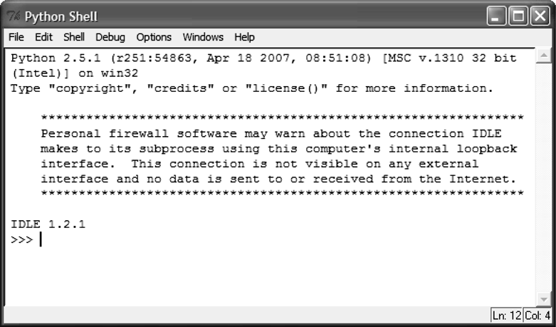
1.5 Using Python
      The IDLE Programming Environment
      Integrated DeveLopment Environment (IDLE)
        Automatically installed when Python language is installed
        It has a built-in text editor
        IDLE editor colorizes code
Figure 1-21 IDLE
1-

Slide 44
Chapter 1
Introduction to Computers and Programming
QUESTIONS
?

